Slide 1

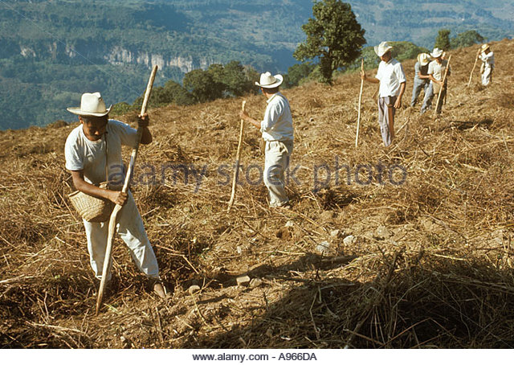

Now I'll get it!
Once upon a time there was a farmer named Aidan. He was a very hardworking man, He used to be in his farm all day, but unfortunately he could make no riches. After years of working and waiting, one day the farmer decided that if he had to become a rich man, the riches would appear before him, right in his living room. So he stopped wishing for riches and spent more time at the farm, working away as hard as he could.
When the farmer was digging his farm he heard a clang in his spade. “This is strange” thought the farmer. He saw a pot of gold coins! “This is amazing! This is just what I wanted .” But after his excitement he thought, “But is this what I wished for. I wished for the riches to appea inn front of my living room .
So the farmer put the pot back from where he found it. When he went back home he told his wife about what happened and his wife was angry for leaving it there. So his wife told their neighbor about this and told them to give the half of the gold when they find it because she was the one who said about it. The neighbor was happy. But the luck was not longer! The pot was filled with snakes!! The farmer thought the wife has planned this is a revenge for their old enmity. So that night the neighbors threw it on Aidan’s living room. In the morning Aidan saw “GOLD” everywhere in his house. He said “ Now I’ll get it! As they appeared in living room.”

