Slide 1
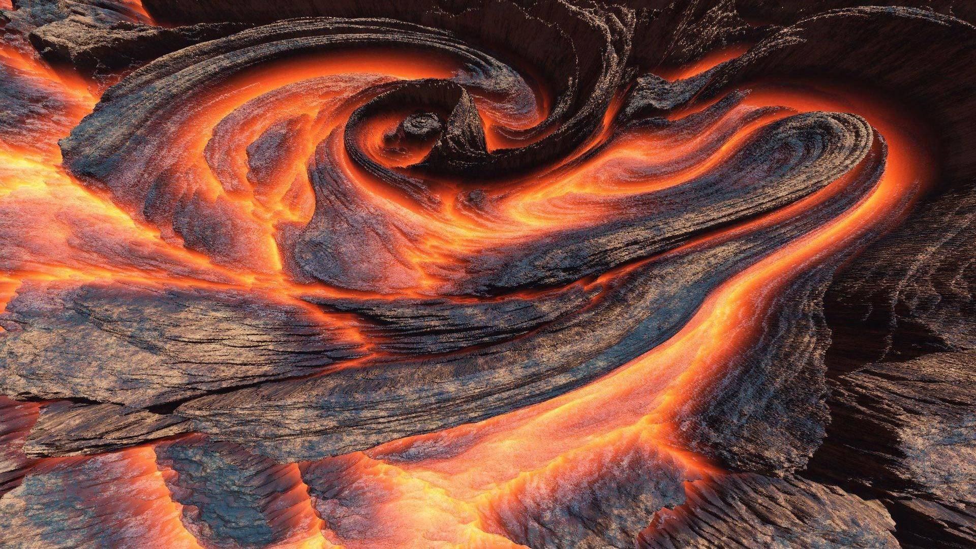
THE magma
Once in a place lived two magnets . The work in a famous hotel named ‘BIRDS SPECIAL ‘ . They were extremely selfish and thus had a lot of snag . There was a worker in the hotel with a goofy in her mouth . Once occurred a magma in the earth ‘ s crust that the people feared . The magnets died . The lady with a good was havinga very involved a very small detail or difference . A recidivist came to the town and probably destroyed everything . The lady with the goofy turned bad and became wealthy .

Slide 2
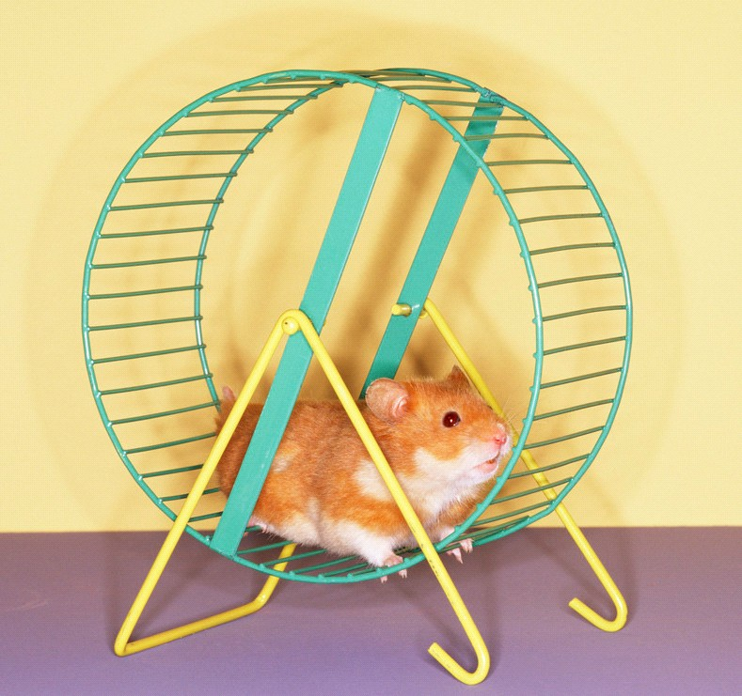
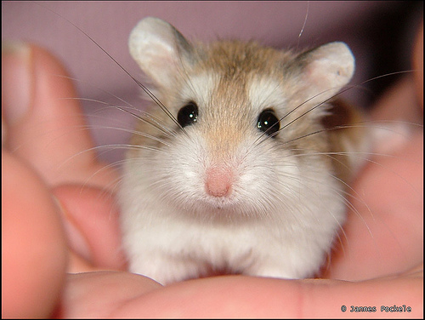
मेरा पालतू जानवर
मैं एक पालतू हम्सटर है,
शराबी और मिठाई।
जब मैं कहता हूँ 'यहाँ, अपना खाना ले',
यह अपने हम्सटर पहिया में कूदता है।
यह मेरे हाथ बदबू आ रही है जब मुझे लगता है,
कुछ गड़बड़ है ।
यह पूरी दुनिया में मेरे सबसे अच्छे पालतू है।
Fareeha मोहम्मद Imthiyas
छठी - 'ए‘

