Slide 1
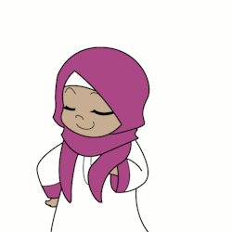


Pedagogy IS everything
By : Fareeha Mohamed Imthiyas
VI – ‘A’
All we need for our future is EDUCATION . It might .. Or it is true that education nowadays is just a wind like WHEN WE NEED WE TAKE AND WHEN WE DON’T WANT WE JUSTBLOW . Everyone’s aim is now to become a great scientists and stuff but .. They FORGET education .? Do you think we don’t education? Why ? We don't need to be afraid of anything and we should say to ourselves . We might belong to any religion but what matters is …… Yes that's right. Now I’m telling these things because I want all to STUDY . And I education from SHINING STAR INTERNATIONAL SCHOOL . We all will surely get education from there .

Slide 2




Now apple , before apple
By : Fareeha Mohamed Imthiyas
VI-’A’
Ohhh…. I forgot the world changed . That was nothing what I was talking about but now I was telling something related apple to my friend and she just freaked out . The thing is olden days it was just the juicy, fruity and tasty apple but … now it is a worldwide used electronic device . I seriously don't know how it changed but the thing is I just ask only one small question why do you use mobile ? For what ? Is it useful ? Please say me about these because I only say DON’T CHANGE THE GODGIVENFOOD TO AN ELECTRIC DEVICE .

Slide 3












flora
Haaaaaaan…… nice topic atlast . Flora usually means Flower . But don’t think Fauna – Hahahahaha . We are really attracted of flowers . Especially girls , The smell is great so we make perfumes . But the people who don’t know the value of flowers , don’t know the true value of color – A famous quote said by …… hahahaha Fareeha Mohamed Imthiyas of class VI- ‘A’ .

